Slide 1
Software Engineering Lecture 3
By
Engr. Sara Rehmat
MS (CS)

Slide 2
Topics to be covered
Software Engineering as Layered Technology
Software Process
Software Process Framework
Process Flow
Software Process Models

Slide 3
A Layered Technology
tools
methods
process model
a “quality” focus
Software Engineering

Slide 4
Software Process
Process
A process is a collection of activities, actions and tasks that are performed when some work product is to be created.
An activity strives to achieve broad objective (e.g., communication with stakeholders) and is applied regardless of the application domain, size of the project, complexity of the effort, or degree of rigor with which software engineering is to be applied.
An action (e.g., architectural design) encompasses a set of tasks that produce a major work product (e.g., an architectural design model).
A task focuses on a small, but well-defined objective (e.g., conducting a unit test) that produces a tangible outcome.

Slide 5
Software Process – contd..
Is “process” synonymous with software engineering?
A software process defines the approach that is taken as software is engineered. But software engineering also encompasses technologies that populate the process—technical methods and automated tools.

Slide 6
Software Process Framework
Each of these activities, actions, and tasks reside within a framework or model that defines their relationship with the process and with one another.
A process framework establishes the foundation for a complete software engineering process by identifying a small number of framework activities that are applicable to all software projects, regardless of their size or complexity.

Slide 7
Generic Framework Activities
Communication: The intent is to understand stakeholders’ objectives for the project and to gather requirements that help define software features and functions.
Planning: The planning activity creates a “map” that helps guide the team as it makes the journey. The map—called a software project plan—defines the software engineering work by describing the technical tasks to be conducted, the risks that are likely, the resources that will be required, the work products to be produced, and a work schedule.

Slide 8
Generic Framework Activities – cntd..
Modeling. A software engineer creates models to better understand software requirements and the design that will achieve those requirements.
Construction. This activity combines code generation (either manual or automated) and the testing that is required to uncover errors in the code.
Deployment. The software (as a complete entity or as a partially completed increment) is delivered to the customer who evaluates the delivered product and provides feedback based on the evaluation.

Slide 9
Umbrella Framework Activities
Umbrella activities are applied throughout a software project and help a software team manage and control progress, quality, change, and risk. Typical umbrella activities include:
Software project tracking and control—allows the software team to assess progress against the project plan and take any necessary action to maintain the schedule.
Risk management—assesses risks that may affect the outcome of the project or the quality of the product.
Software quality assurance—defines and conducts the activities required to ensure software quality.
Technical reviews—assesses software engineering work products in an effort to uncover and remove errors before they are propagated to the next activity.

Slide 10
Umbrella Framework Activities
Measurement—defines and collects process, project, and product measures that assist the team in delivering software that meets stakeholders’ needs; can be used in conjunction with all other framework and umbrella activities.
Software configuration management—manages the effects of change throughout the software process.
Reusability management—defines criteria for work product reuse (including software components) and establishes mechanisms to achieve reusable components.
Work product preparation and production—encompasses the activities required to create work products such as models, documents, logs, forms, and lists.

Slide 11
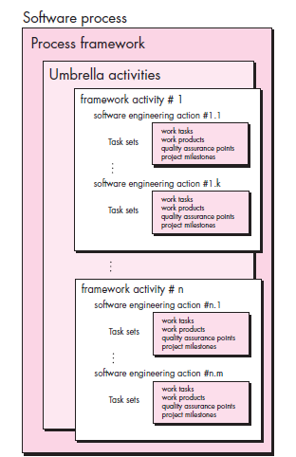

Slide 12
Process Flow
Process Flow describes how the framework activities and the actions and tasks that occur within each framework activity are organized with respect to sequence and time .
A linear process flow executes each of the five framework activities in sequence, beginning with communication and culminating with deployment.
An iterative process flow repeats one or more of the activities before proceeding to the next.
An evolutionary process flow executes the activities in a “circular” manner. Each circuit through the five activities leads to a more complete version of the software.
A parallel process flow executes one or more activities in parallel with other activities (e.g., modeling for one aspect of the software might be executed in parallel with construction of another aspect of the software).

Slide 13
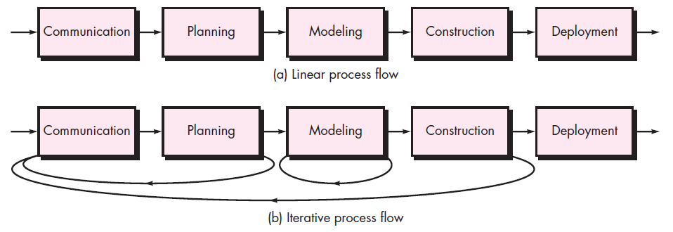
Process Flow

Slide 14
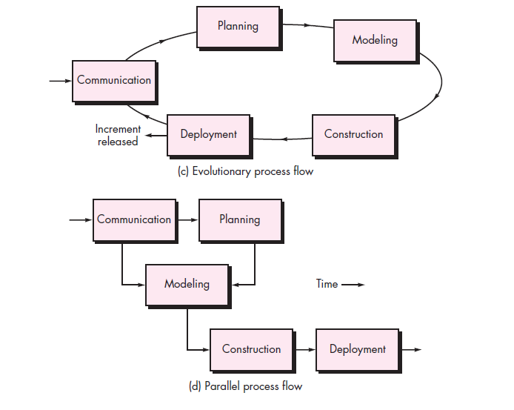
Process Flow

Slide 15
Process Flow Models

Slide 16
The Waterfall Model
There are times when the requirements for a problem are well understood and reasonably stable—when work flows from communication through deployment in a reasonably linear fashion.
The waterfall model is mostly used for large systems engineering projects where a system is developed at several sites.
In those circumstances, the plan-driven nature of the waterfall model helps coordinate the work.

Slide 17
The Waterfall Model

Slide 18
The Waterfall Model
The result of each phase is one or more documents that are approved (‘signed off’). The following phase should not start until the previous phase has finished.
In practice, these stages overlap and feed information to each other. During design, problems with requirements are identified. During coding, design problems are found and so on. The software process is not a simple linear model but involves feedback from one phase to another.
Documents produced in each phase may then have to be modified to reflect the changes made.
Because of the costs of producing and approving documents, iterations can be costly and involve significant rework. Therefore, after a small number of iterations, it is normal to freeze parts of the development, such as the specification, and to continue with the later development stages.
Although the original waterfall model proposed by Winston Royce made provision for “feedback loops,” the vast majority of organizations that apply this process model treat it as if it were strictly linear.

Slide 19
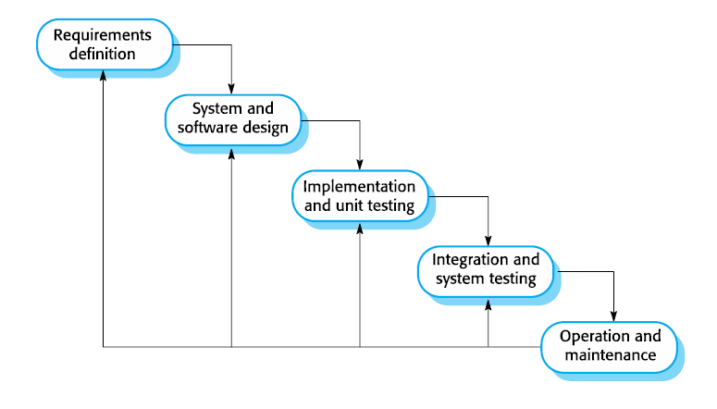
The Waterfall Model

Slide 20
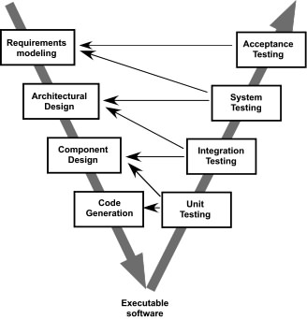
The V-Model – A variation of the Waterfall Model

Slide 21
The V-Model
As a software team moves down the left side of the V, basic problem requirements are refined into progressively more detailed and technical representations of the problem and its solution.
Once code has been generated, the team moves up the right side of the V, essentially performing a series of tests (quality assurance actions) that validate each of the models created as the team moved down the left side.
In reality, there is no fundamental difference between the classic life cycle and the V-model. The V-model provides a way of visualizing how verification and validation actions are applied to earlier engineering work.

Slide 22
Drawbacks of Waterfall Model
The main drawback of the waterfall model is the difficulty of accommodating change after the process is underway. In principle, a phase has to be completed before moving onto the next phase.
Inflexible partitioning of the project into distinct stages makes it difficult to respond to changing customer requirements. Therefore, this model is only appropriate when the requirements are well-understood and changes will be fairly limited during the design process.
Few business systems have stable requirements.

Slide 23
Drawbacks of Waterfall Model
It is often difficult for the customer to state all requirements explicitly. The waterfall model requires this and has difficulty accommodating the natural uncertainty that exists at the beginning of many projects.
The customer must have patience. A working version of the program(s) will not be available until late in the project time span. A major blunder, if undetected until the working program is reviewed, can be disastrous.
The premature freezing of requirements may mean that the system won’t do what the user wants. It may also lead to badly structured systems as design problems are circumvented by implementation tricks.

Slide 24
The Incremental Model
There are many situations in which initial software requirements are reasonably well defined, but the overall scope of the development effort precludes a purely linear process.
In addition, there may be a compelling need to provide a limited set of software functionality to users quickly and then refine and expand on that functionality in later software releases.
In such cases, you can choose a process model that is designed to produce the software in increments.
The incremental model combines elements of linear and parallel process flows.
The incremental model applies linear sequences in a staggered fashion as calendar time progresses. Each linear sequence produces deliverable “increments” of the software in a manner that is similar to the increments produced by an evolutionary process flow.

Slide 25
The Incremental Model

Slide 26
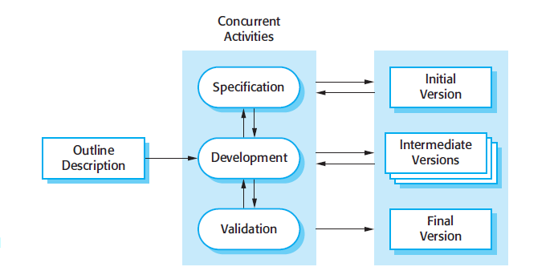
The Incremental Model

Slide 27
Benefits
The cost of accommodating changing customer requirements is reduced.
The amount of analysis and documentation that has to be redone is much less than is required with the waterfall model.
It is easier to get customer feedback on the development work that has been done. Customers can comment on demonstrations of the software and see how much has been implemented.
More rapid delivery and deployment of useful software to the customer is possible.

Slide 28
Drawbacks
The process is not visible. Managers need regular deliverables to measure progress. If systems are developed quickly, it is not cost-effective to produce documents that reflect every version of the system.
System structure tends to degrade as new increments are added. Unless time and money is spent on refactoring to improve the software, regular change tends to corrupt its structure.
Incorporating further software changes becomes increasingly difficult and costly.

Slide 29
Evolutionary Models
Software, like all complex systems, evolves over a period of time. Business and product requirements often change as development proceeds, making a straight line path to an end product unrealistic.
Evolutionary models are iterative. They are characterized in a manner that enables you to develop increasingly more complete versions of the software.
Two types
Protoyping
Spiral Model

Slide 30
Evolutionary Models: Prototyping
The prototyping paradigm begins with communication. You meet with other stakeholders to define the overall objectives for the software, identify whatever requirements are known, and outline areas where further definition is mandatory.
A prototyping iteration is planned quickly, and modeling (in the form of a “quick design”) occurs. A quick design focuses on a representation of those aspects of the software that will be visible to end users (e.g., human interface layout or output display formats)
The quick design leads to the construction of a prototype. The prototype is deployed and evaluated by stakeholders, who provide feedback that is used to further refine requirements. Iteration occurs as the prototype is tuned to satisfy the needs of various stakeholders, while at the same time enabling you to better understand what needs to be done.
Ideally, the prototype serves as a mechanism for identifying software requirements.
If a working prototype is to be built, you can make use of existing program fragments or apply tools (e.g., report generators and window managers) that enable working programs to be generated quickly.

Slide 31
Evolutionary Models: Prototyping
Quick
plan
communication
Modeling
Quick design
Deployment
delivery &
feedback
Construction
of prototype
Construction
of prototype

Slide 32
Benefits of Prototyping
Improved system usability.
A closer match to users’ real needs.
Improved design quality.
Reduced development effort.

Slide 33
Throw-away Prototypes
Prototypes should be discarded after development as they are not a good basis for a production system
It may be impossible to tune the system to meet non-functional requirements;
Prototypes are normally undocumented;
The prototype structure is usually degraded through rapid change;
The prototype probably will not meet normal organizational quality standards.

Slide 34
Evolutionary Models: The Spiral
Originally proposed by Barry Boehm, the spiral model is an evolutionary software process model that couples the iterative nature of prototyping with the controlled and systematic aspects of the waterfall model. It provides the potential for rapid development of increasingly more complete versions of the software.

Slide 35
Evolutionary Models: The Spiral

Slide 37
Questions

